Slide 1
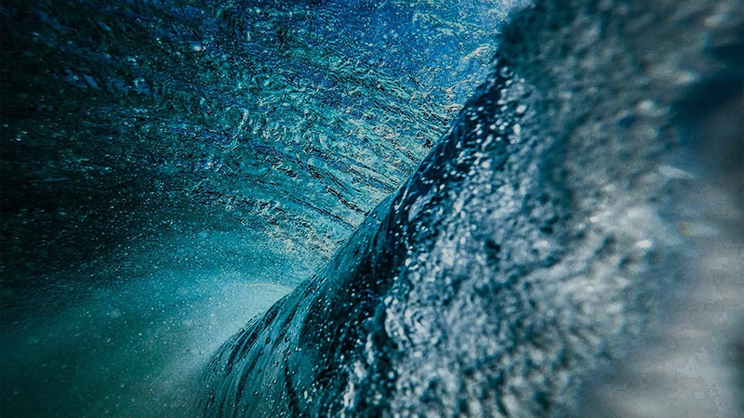
Ocean Acidification
1

Slide 2
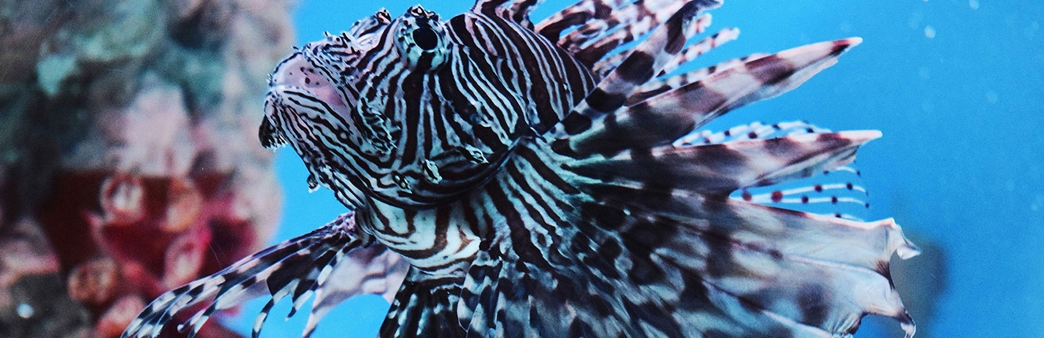
Our ocean acts as a carbon sink and absorbs carbon dioxide from the atmosphere.

Slide 3

In the past 200 years the amount of carbon dioxide in the atmosphere has increased by more than 35% due to the large amount of fossil fuels that have been used.
A substantial part of this carbon dioxide is absorbed by the Ocean where the carbon dioxide reacts with water molecules to form carbonic acid, causing a decrease in the pH of the ocean water.
3

Slide 4
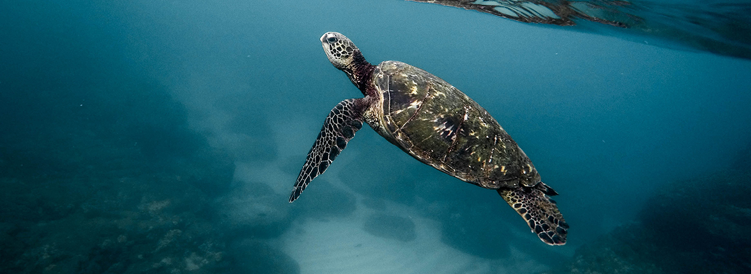
This increased acidity negatively impacts the ability of many marine organisms to form their shells and other structural frameworks.

Slide 5
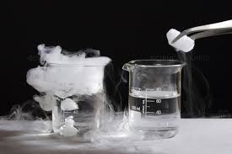
Using Dry Ice
In the demonstration the increased carbon dioxide levels, resulting from the dry ice, and the decreased pH as shown by the pH indicator, represent ocean acidification that is occurring due to human influences.
5

